Slide 1
Entertainer Data Analysis

Slide 2
Objective:
Normal life can be stressful, and people need to relax. Being entertained by others is a wonderful way to take some time out of life. It can reduce stress and make life’s issues easier to face. The media and entertainment industry consists of films, television, radio and print. These segments include movies, TV shows, radio shows, news, music, newspapers, magazines and books. Entertainment industry is a group of sub-industries devoted to entertainment. Entertainment industry is used to describe the mass media companies that control the distribution and manufacture of mass media entertainment.

Slide 3
Benefits:
User can easily analyze about their favorite entertainer through the dashboard in terms of hoe many awards he/she won.

Slide 4
Tasks:
Write the process and data added to the current dataset.
Add some data as per convenience.
Do the data preparation part.
Build the dashboards.
Build a storyline

Slide 5
Data Preparation And Description:
Data was given in three parts:
Entertainer – basic info
Entertainer – breakthrough info
Entertainer – last work info
Given data is not much sufficient for analysis, so additional information is required.
Number of awards, nominees, awards from breakthrough etc., are added to the data set.

Slide 6
Column Name | Description
Entertainer | Name of Entertainer
Profession | Category of Entertainer
Gender | Gender of Entertainer
Birth Year | Birth year of entertainer
Year of Breakthrough | Year of breakthrough of entertainer. Breakthrough means super hit or career changing performance by entertainer.
Breakthrough name | Name of breakthrough. It can be musical album, TV shows, movie etc.
Year of First Awards | Year of first mega award won by entertainer.
Year of Last Major Work | Last appearance of that entertainer.
Year of Death | Death of that entertainer(if they die).
Total Awards won | Total number of awards won by entertainer
Total Nominees | Total number of nominees by entertainer for whichever award.
Oscar won | Number of total Oscars won by entertainer
Grammy won | Number of total Grammy won by entertainer.
Emmy won | Number of total Emmies won by entertainer.
No. of other awards won | Number of total other awards won by entertainer
Awards won from Breakthrough | Any awards from breakthrough.

Slide 7



Tools Used:

Slide 8
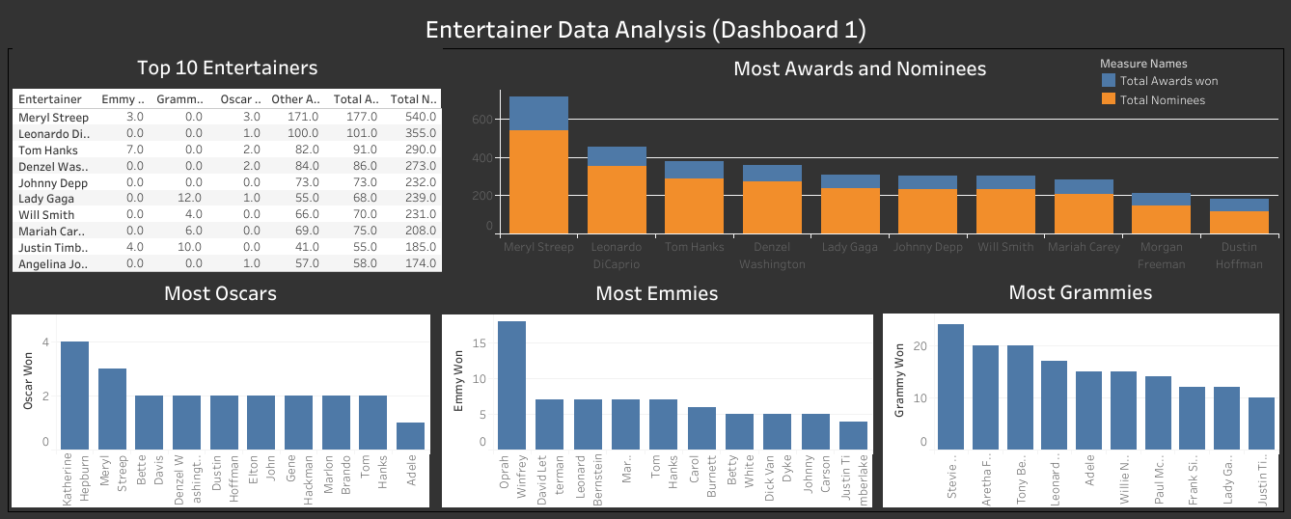
Dashboard 1

Slide 9
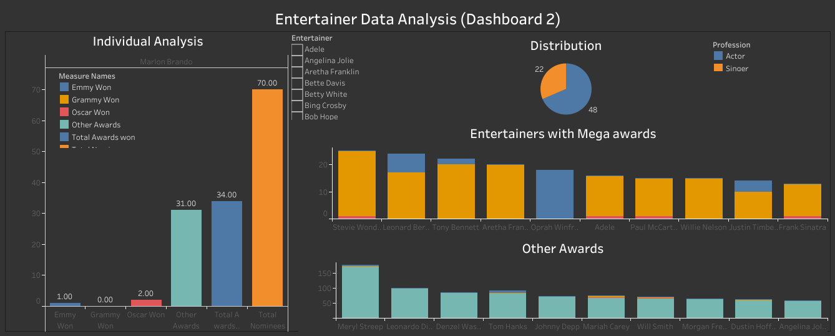
Dashboard 2

Slide 10
Analysis:
Maximum awards won by Actors 1709 and Singers 640.
Mery Streep is the best Entertainer with 177 Awards including 3 Oscars, 3 Emmies also she has 540 nominees.
Katherine Hepburn has highest Oscars (4).
Orpah Winfrey has highest Emmies (18).
Stevie Wonder has highest Grammies (24)’
In 1962, the entertainer got maximum awards.

